Slide 1
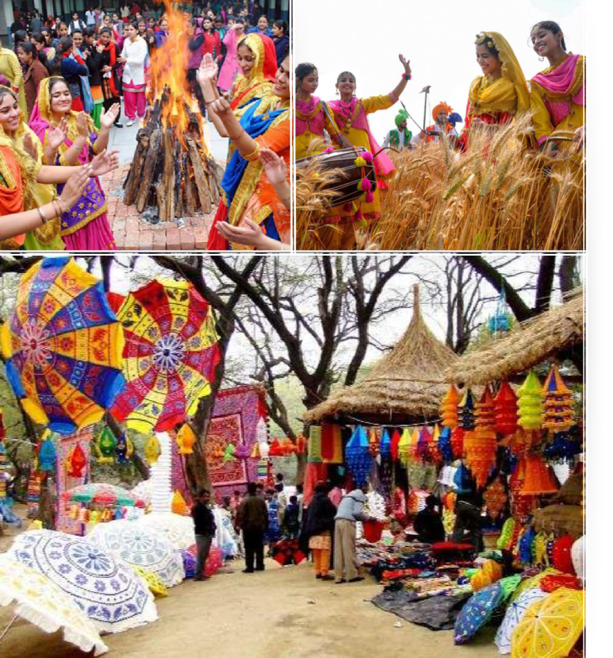

Haryana

Slide 2
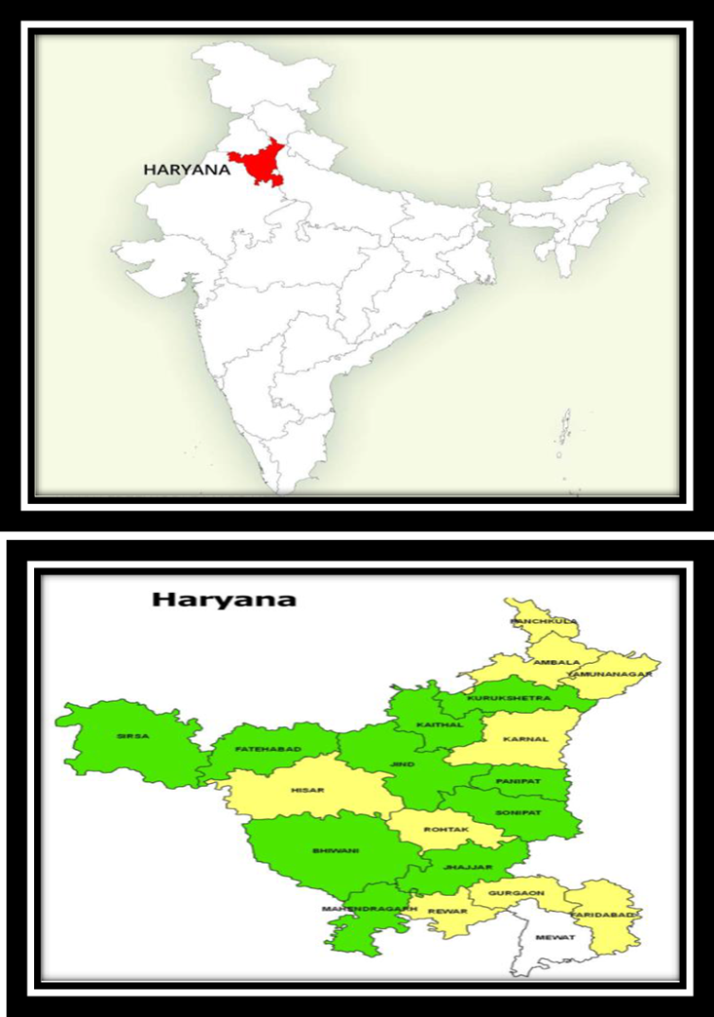
CARVED OUT OF THE FORMER STATE OF EAST PUNJAB ON 1 NOVEMBER 1966 ON A LINGUISTIC BASIS CAPITAL & MOST POPULOUS CITY IS FARIDABAD. FINANCIAL AND TECHNOLOGY HUBS. AND PART OF NCR. ALSO CONSIDERED ONE OF THE MAJOR INFORMATION TECHNOLOGY AND AUTOMOBILE HUBS OF INDIA.
RICH IN HISTORY, MONUMENTS, HERITAGE, FLORA AND FAUNA AND TOURISM, WITH A WELL DEVELOPED ECONOMY, NATIONAL HIGHWAYS AND STATE ROADS, IT IS BORDERED BY HIMACHAL PRADESH TO THE NORTH-EAST, BY RIVER YAMUNA ALONG ITS EASTERN BORDER WITH UTTAR PRADESH, BY RAJASTHAN TO THE WEST AND SOUTH, AND GHAGGAR-HAKRA RIVER FLOWS ALONG ITS NORTHERN BORDER WITH PUNJAB.

Slide 3
Haryana Core Team
Speaker – Sol. RICHA
Deputy Speaker – Sol. SUNITA CALESTIO
Co-ordinator – Sol. USHA SHARMA
Secretary – Sol. MAMTA/SEEMA

Slide 4

Constituencies of Haryana

Slide 5
SMPs | CONSTITUENCIES
AMBALA | SOL. KAMLA
KURUKSHETRA | SOL. GRACY
SIRSA | SOL. KAMLESH
HISSAR | SOL. MANU
KARNAL | SOL. USHA
SONIPAT | SOL. KAMAL KUMARI
ROHTAK | SOL. KAJAL
BHIWANI-MAHENDARGARH | SOL. SANGEETA
GURGAON | SOL. NEELAM SHARMA
FARIDABAD | SOL. VANITHA

Slide 6

SMLAs Constituencies and Incumbents

Slide 7
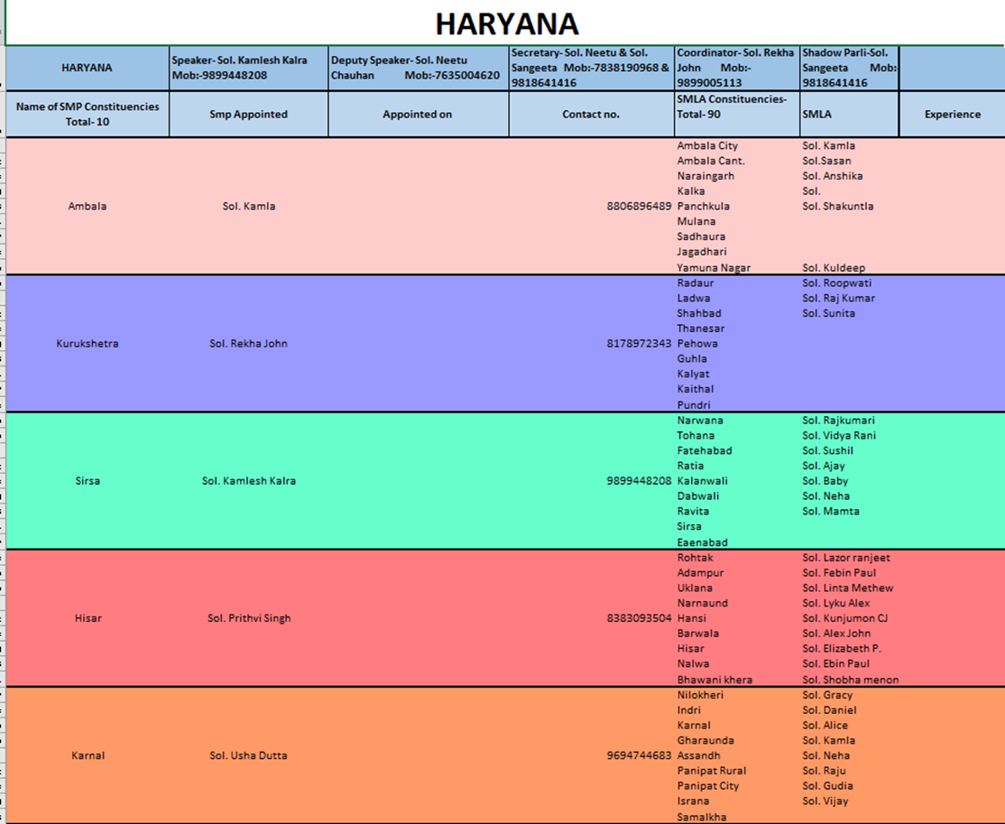

Slide 8
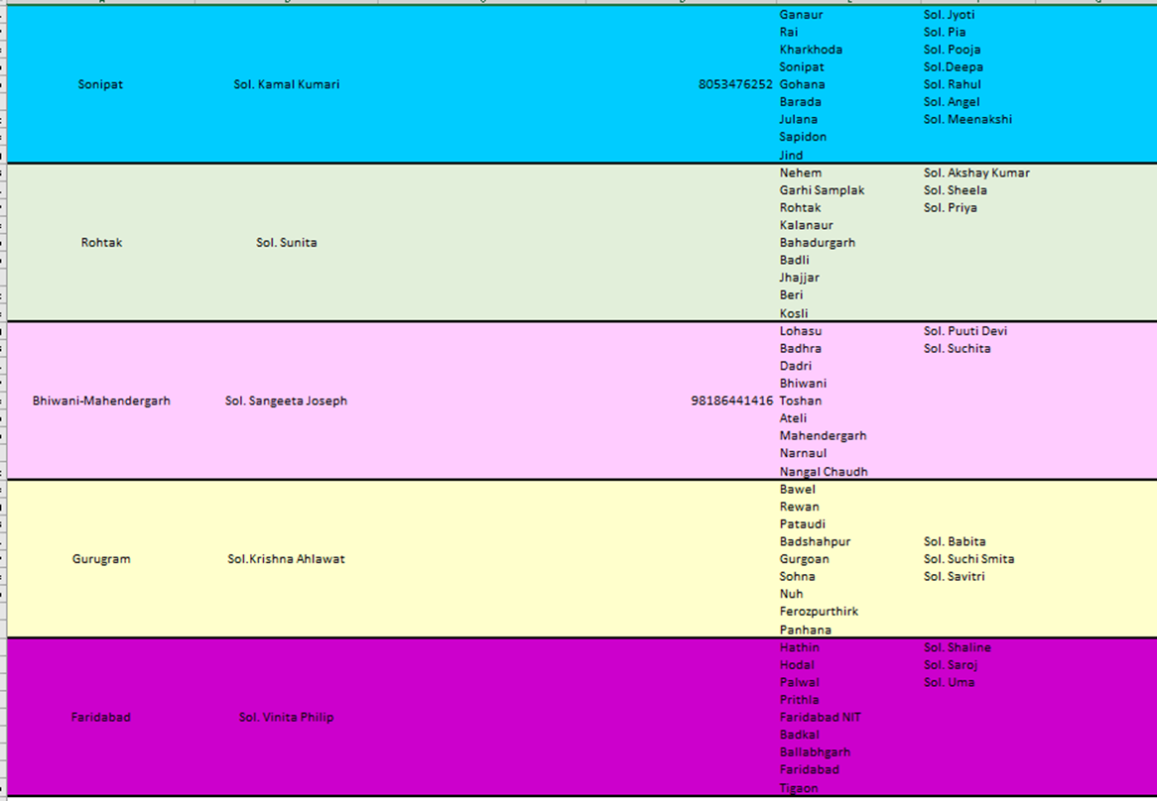

Slide 9

Haryana Troop Church Report
JULY 2024

Slide 10

TROOP CHURCH

Slide 11
LEADER : SOL.USHA
DATE: 01/07/24 TO 07/07/24
TIME : 12:00 TO 1:30 PM
MEMBERS : 09- 10
ABRAHAM TROOP CHURCH

Slide 12
PETER TROOP CHURCH
Leader- Sol. RICHA JAIN
Date : 15/07/2024 to 24 /07 /2024
Time : 12 :00 to 1:30 PM
MEMBERS : 06-07

Slide 13
testimony
Sol. Mamta met with an accident. God saved her as she received only bruises in some areas of her body. she is better now . God has healed her. . Sister gives all glory to God.
Sol. Pramila was not feeling well . She became little better after the prayers were done for her in the troop church. She is grateful to God.
Sol. Sheelu had asked for prayers . All the soldiers prayed for her in the troop church after which she felt little relieved.

Slide 14

ARMY OF JESUS OPERATIONS

Slide 15
Gift Schools

Slide 16

NAZARETH SCHOOL OF FAMILY BUILDING
DATE : 08 /07/2024TO 14/07/2024
TIME : 12:00 TO 1:30 PM
MEMBERS: 10-12

Slide 17
TESTIMONIES
All the soldiers liked the classes.
Soldiers found the classes to be very informative.
They learnt about godly order in a christian family .
Soldiers also learnt how to destroy the strongholds .
Soldiers learnt about the correct ways of upbringing their children.

Slide 18

MARTHA SCHOOL OF HOSPITALITY
DATE : 25 /07/2024 TO 31/07/24
TIME : 12:00 TO 1:30 PM
MEMBERS: 09-10

Slide 19
. Soldiers have learnt how to show hospitality to others .
SOLDIERS came to know HOW TO deal with difficult people .
. Soldiers learnt about building up godly and good moral character.
.
TESTIMONIES

Slide 20
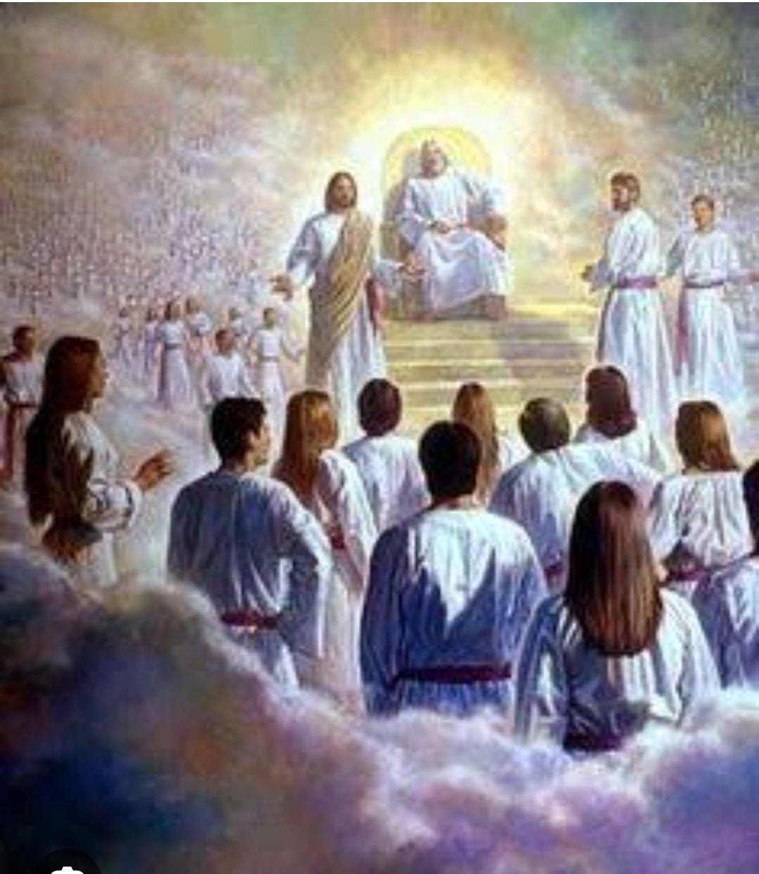
SHADOW PARLI
20/07/24
12:00-1:30pm

Slide 21
MORNING WORSHIP - 05:30 am to 07:00 am

Slide 22
Zonal Meeting
On 24.07.2024
Time: 12:00 pm to 01:30 pm
Members: 09

Slide 23


