Slide 1

NORTH REGION
HARYANA
CRFC MEETING
OCTOBER 2024

Slide 2

CRFC MEETING
IN MONTH OF OCTOBER
VENUE –ROHTAK
DATE -09/10/24

Slide 3
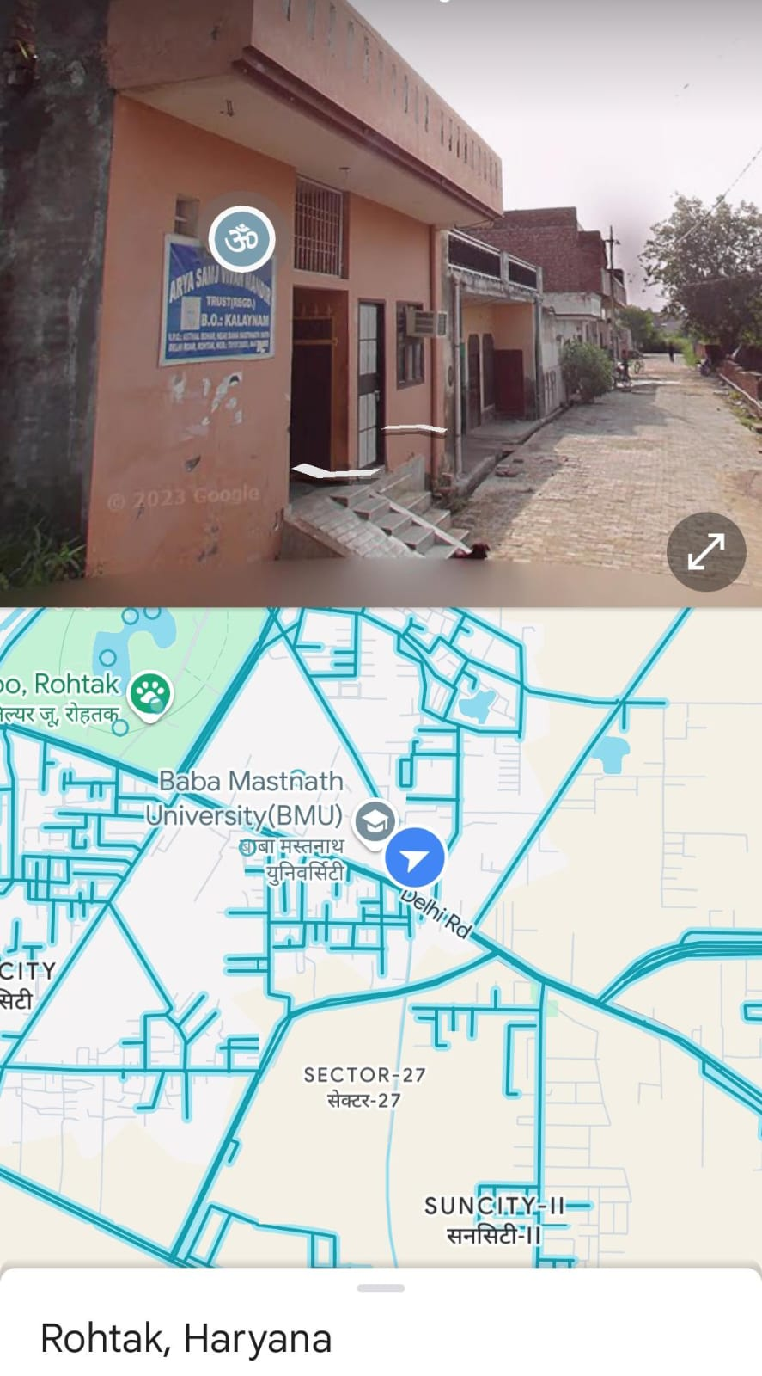
LOCATION IN ROHTAK- ROHTAK BRETHREN
ASSEMBLY

Slide 4
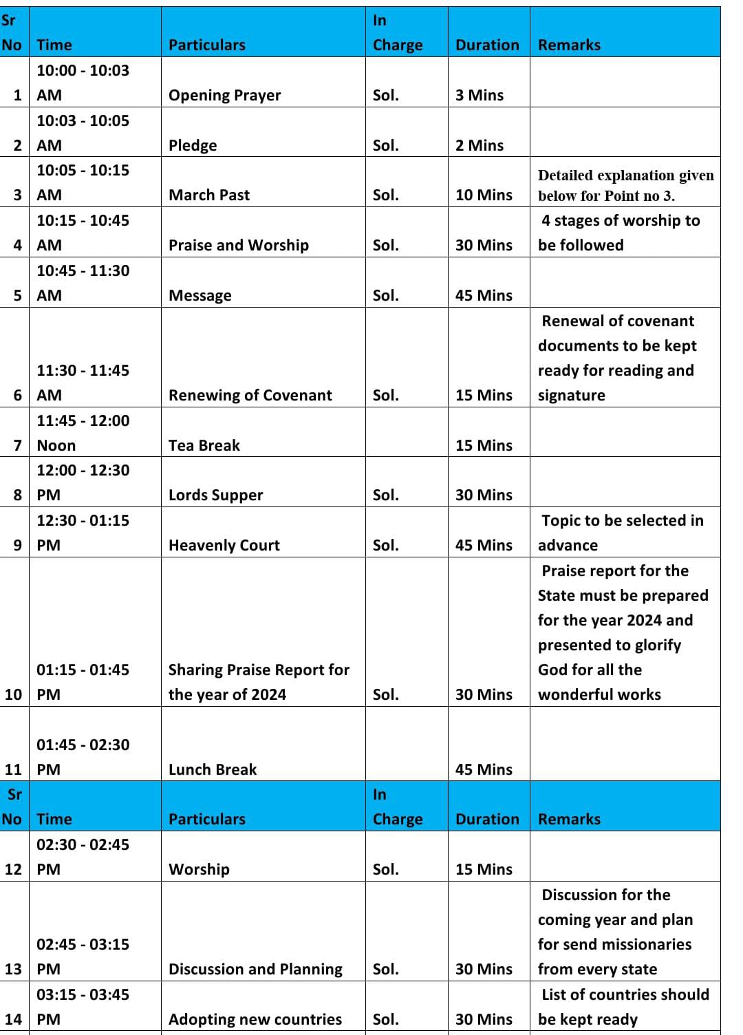
SCHEDULE FOR THE MEETING

Slide 5
TESTIMONIES
We are grateful to God that as we were planning to conduct CRFC meeting in Haryana, we started looking for a centre place so that all soldiers could come for CRFC, we found a number on google and when we contacted the church. They immediately agreed for the meeting and were very positive. Church leader not only denied taking any charges for the hall we used for the entire day but also refused to take any money for breakfast ,lunch and snacks. We could see God’s hand upon us for this meeting.
While we were contacting all the active/inactive soldiers of Haryana , we spoke to a soldier who could never attend our AOJ meetings. He unknowingly mentioned about a 15 day SHEKINAH programme that he did with his wife and was appreciating it. That time only we came to know that he was an old soldier of AOJ. We told him that this is the same group in which we added him just a few months back. He had forgotten the name AOJ and was very happy after knowing that this is the same group from where he did his previous training.

Slide 6
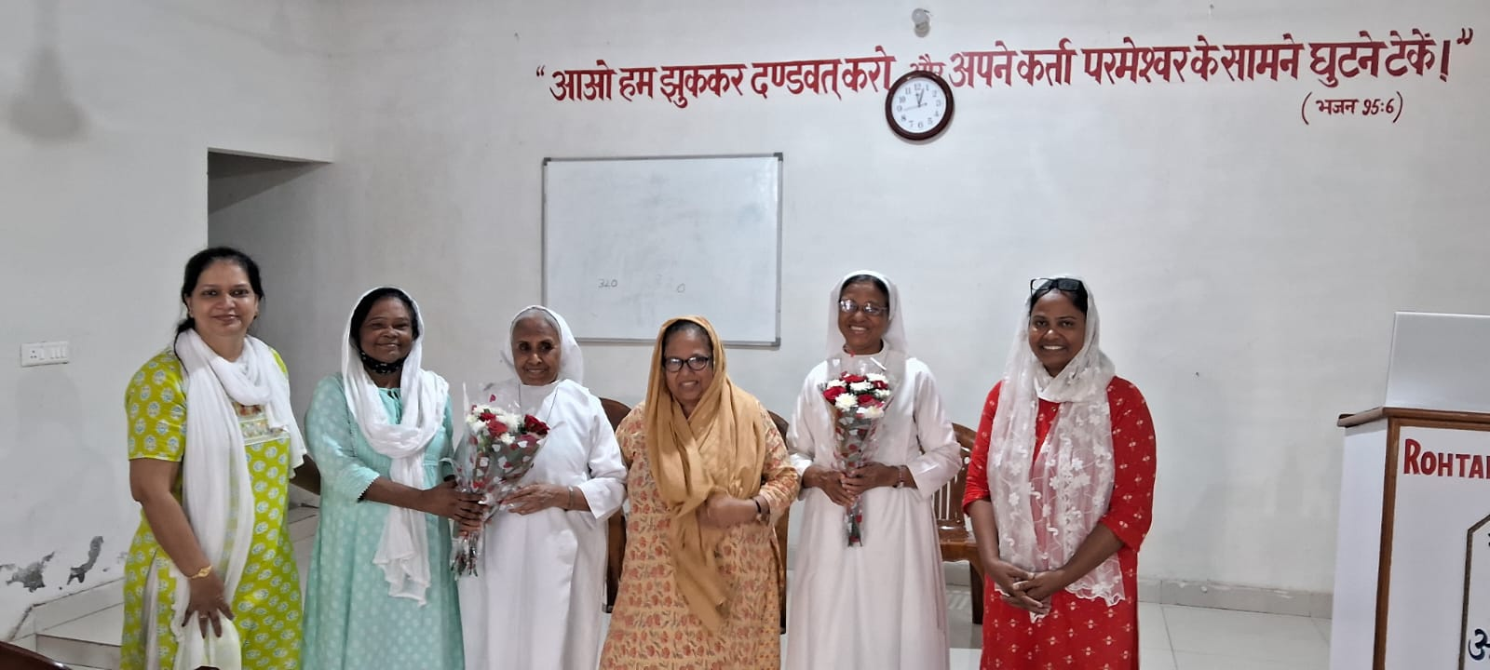
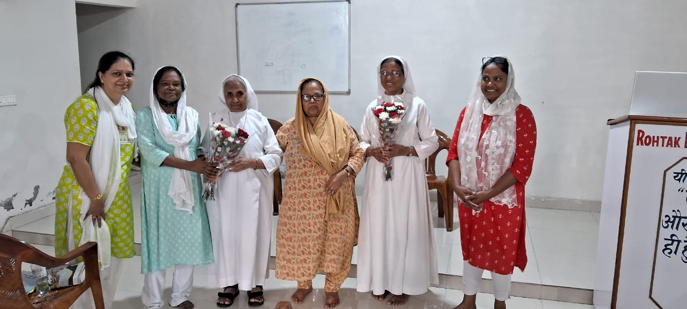
SOME GLIMPSES FROM CRFC-HARYANA

Slide 7
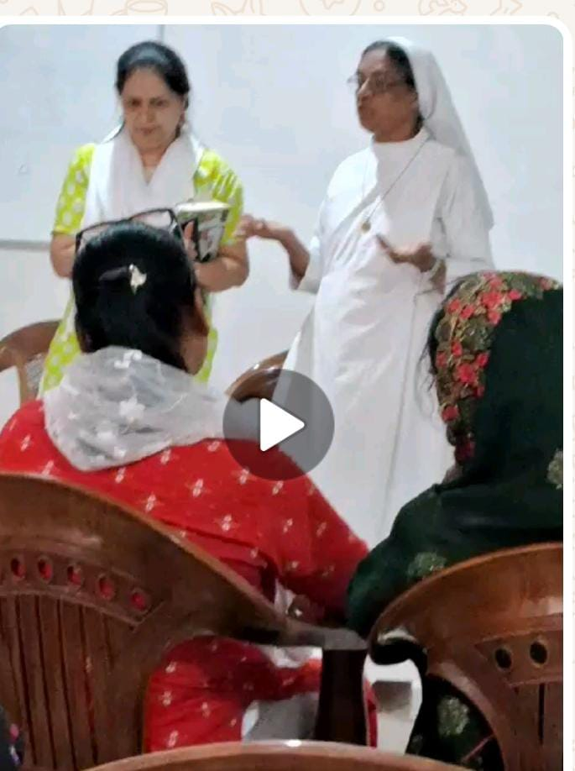
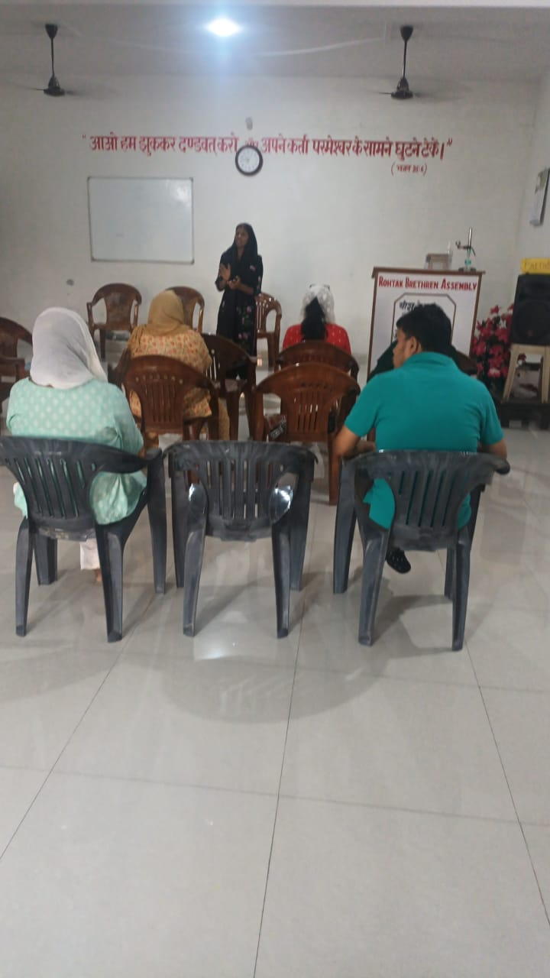
SISTER ANGELICA TAKING MESSAGE

Slide 8
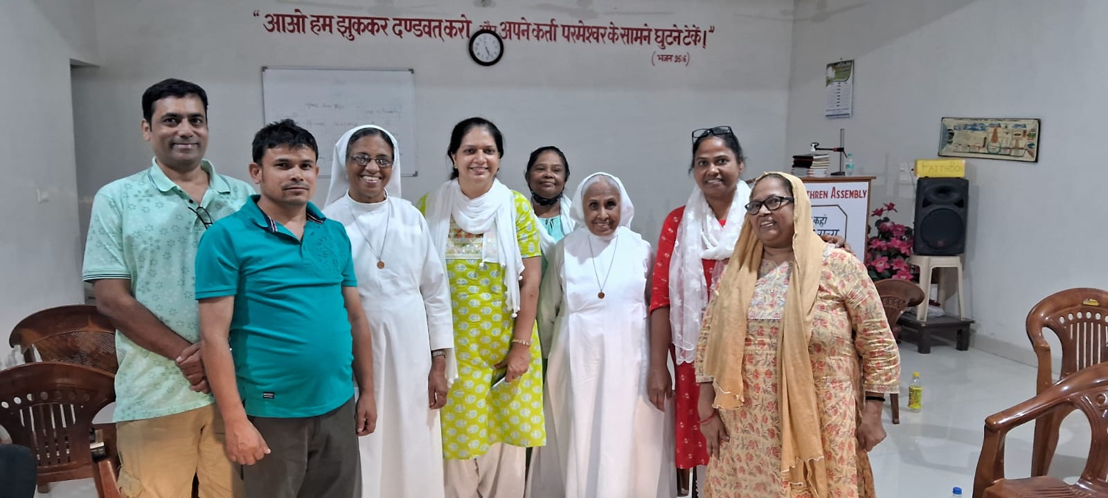
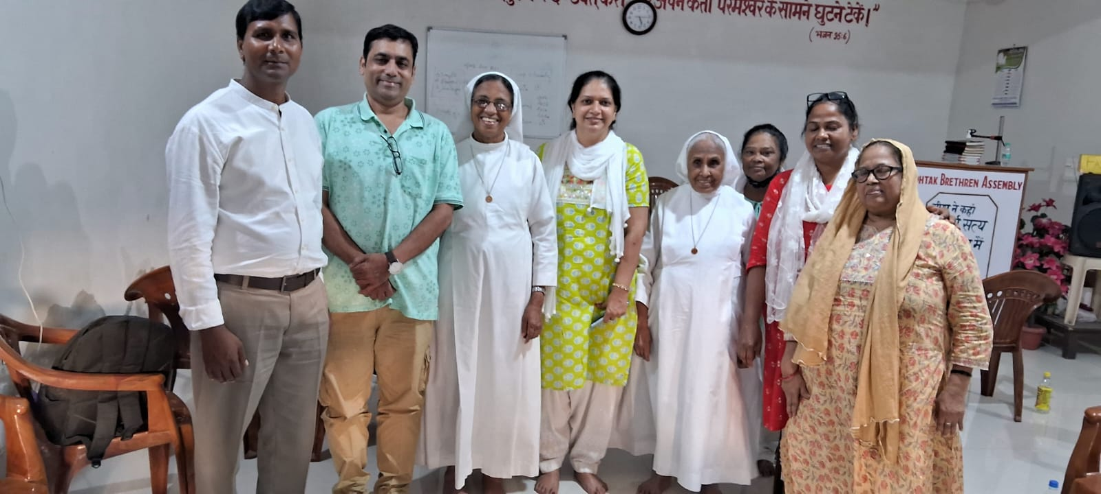

Slide 9
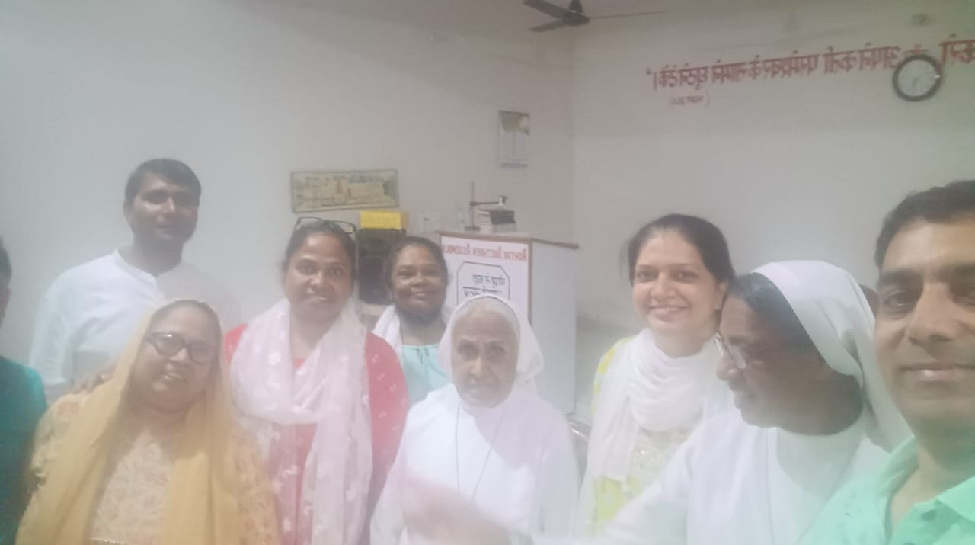

Slide 10
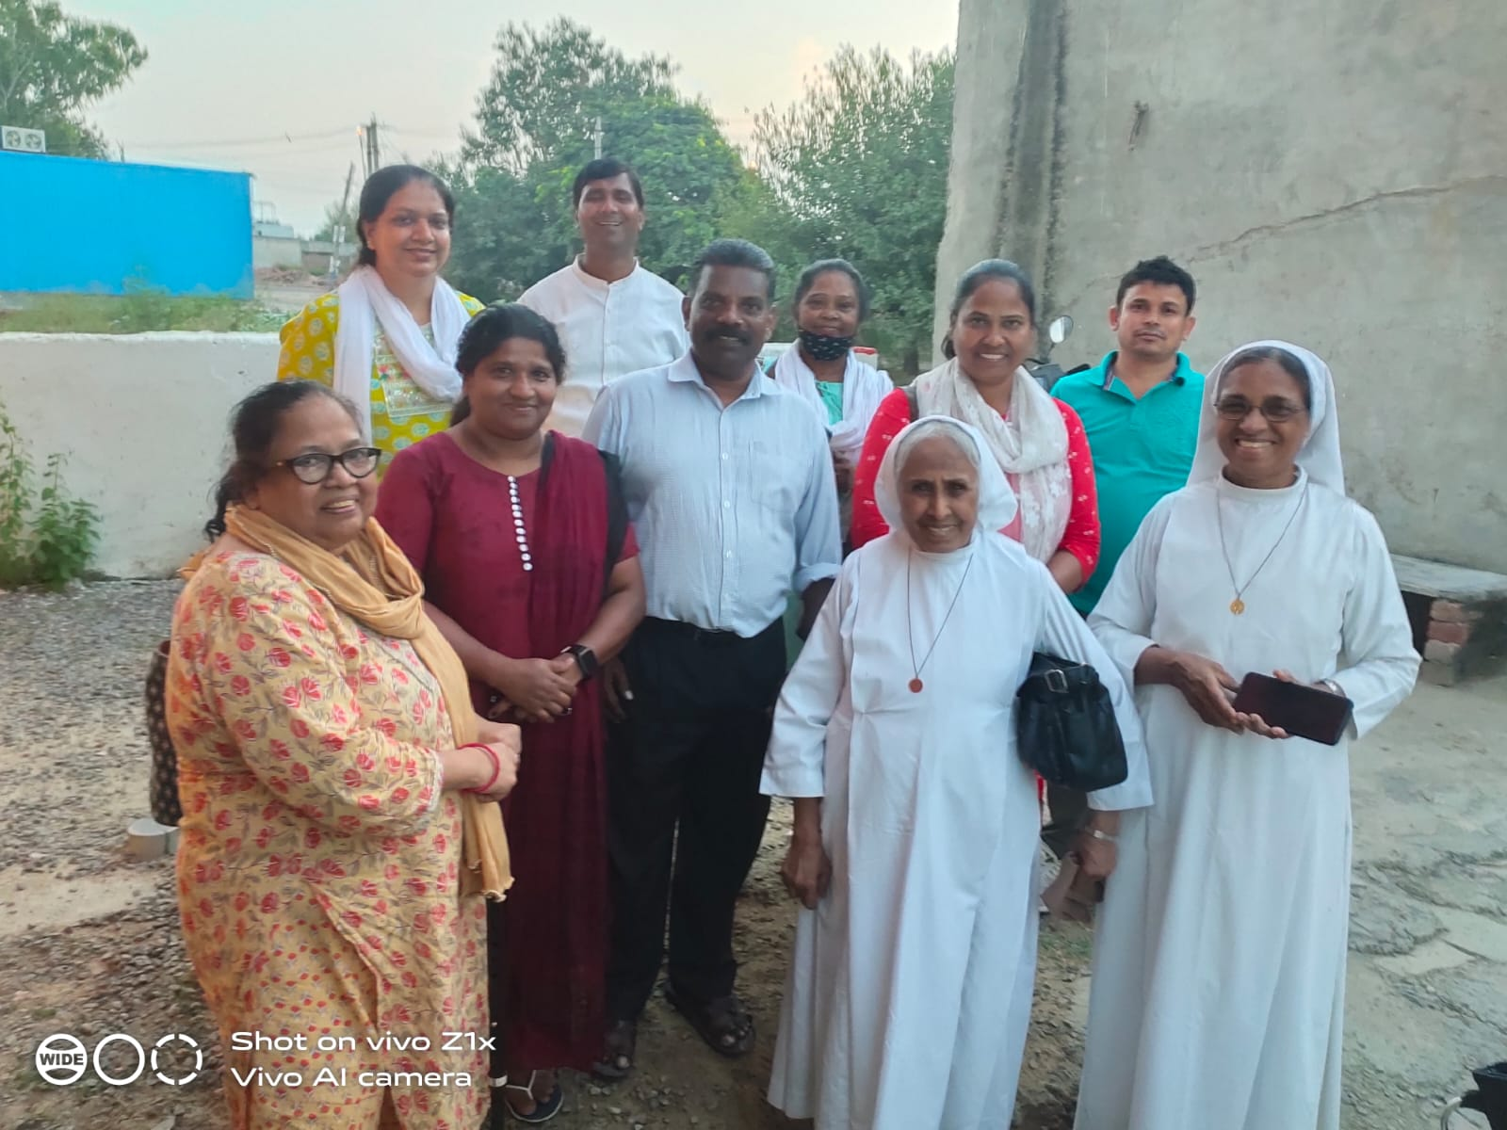

Slide 11


