Slide 1

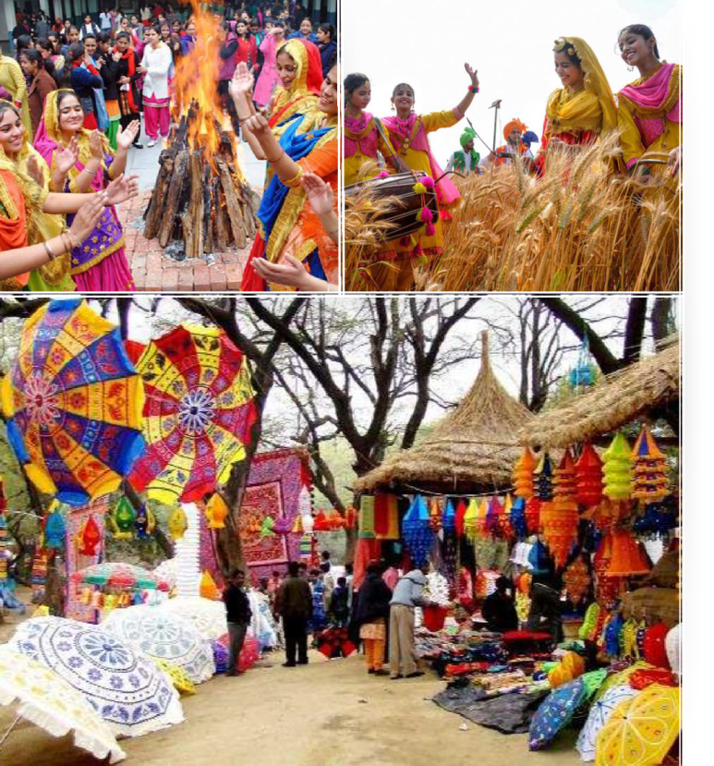
Haryana

Slide 2
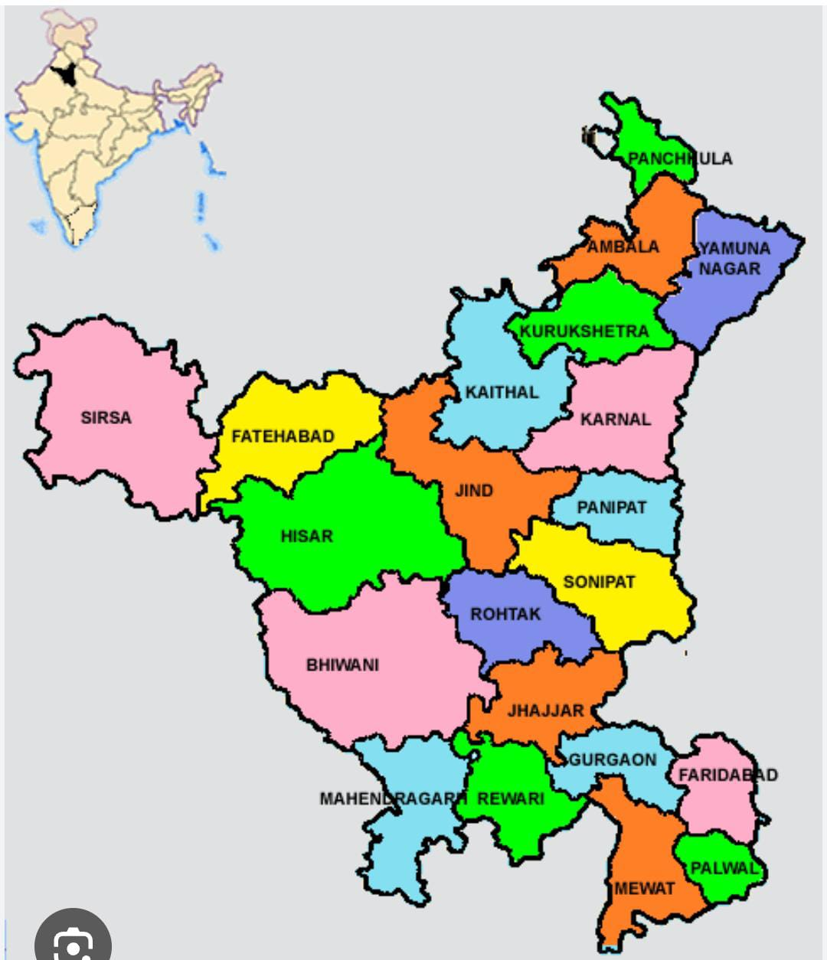
DISTRICTS OF HARYANA

Slide 3
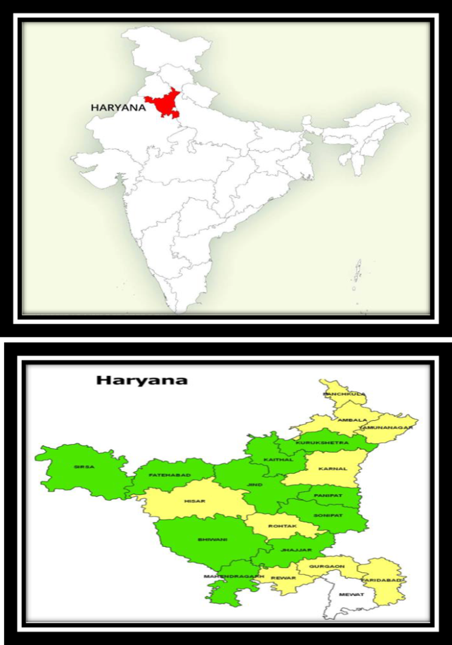
CARVED OUT OF THE FORMER STATE OF EAST PUNJAB ON 1 NOVEMBER 1966 ON A LINGUISTIC BASIS CAPITAL & MOST POPULOUS CITY IS FARIDABAD. FINANCIAL AND TECHNOLOGY HUBS. AND PART OF NCR. ALSO CONSIDERED ONE OF THE MAJOR INFORMATION TECHNOLOGY AND AUTOMOBILE HUBS OF INDIA.
RICH IN HISTORY, MONUMENTS, HERITAGE, FLORA AND FAUNA AND TOURISM, WITH A WELL DEVELOPED ECONOMY, NATIONAL HIGHWAYS AND STATE ROADS, IT IS BORDERED BY HIMACHAL PRADESH TO THE NORTH-EAST, BY RIVER YAMUNA ALONG ITS EASTERN BORDER WITH UTTAR PRADESH, BY RAJASTHAN TO THE WEST AND SOUTH, AND GHAGGAR-HAKRA RIVER FLOWS ALONG ITS NORTHERN BORDER WITH PUNJAB.

Slide 4
Haryana Core Team
Speaker – Sol. RICHA
Deputy Speaker – Sol. SUNITA CALESTIO
Co-ordinator – Sol. USHA SHARMA
Secretary – Sol. MAMTA / SEEMA

Slide 5

Constituencies of Haryana

Slide 6
SMPs | CONSTITUENCIES
ALISTOOOOOOOOOOMBALA | SOL. KAMLA
AMBALA KURUKSHETRA | SOL. GITA JESSI SOL. RICHA JAIN
SIRSA | SOL. KAMLESH
HISSAR KARNAL | SOL. RAJENDRA SOL. SHEELU
KARNAL | SOL. USHA
SONIPAT ROHTAK | SOL. LATA SOL. RAJVEER
ROHTAK | SOL. KAJAL
BHIWANI-MAHENDARGARH SIRSA | SOL. SEEMA SOL. MAMTA
FARIDABAD | SOL. USHA SHARMA

Slide 7


SMLAs Constituencies and Incumbents

Slide 8
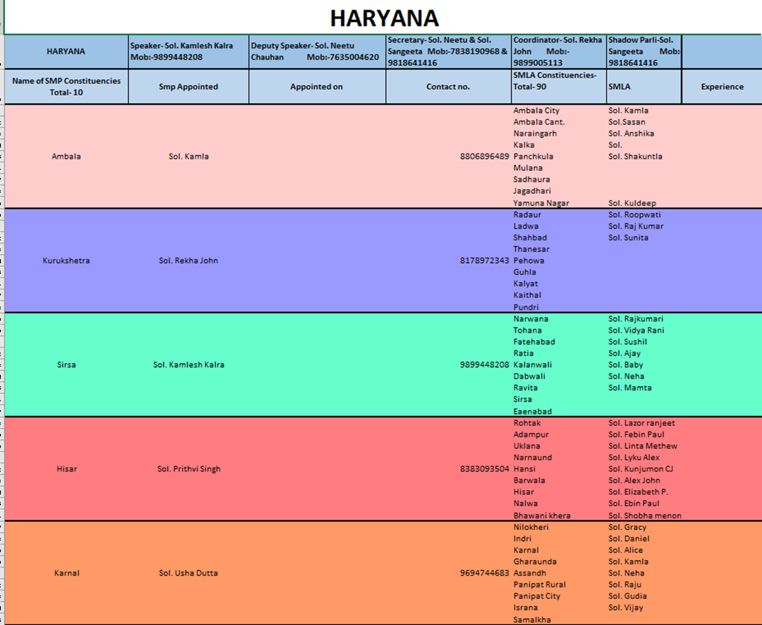

Slide 9
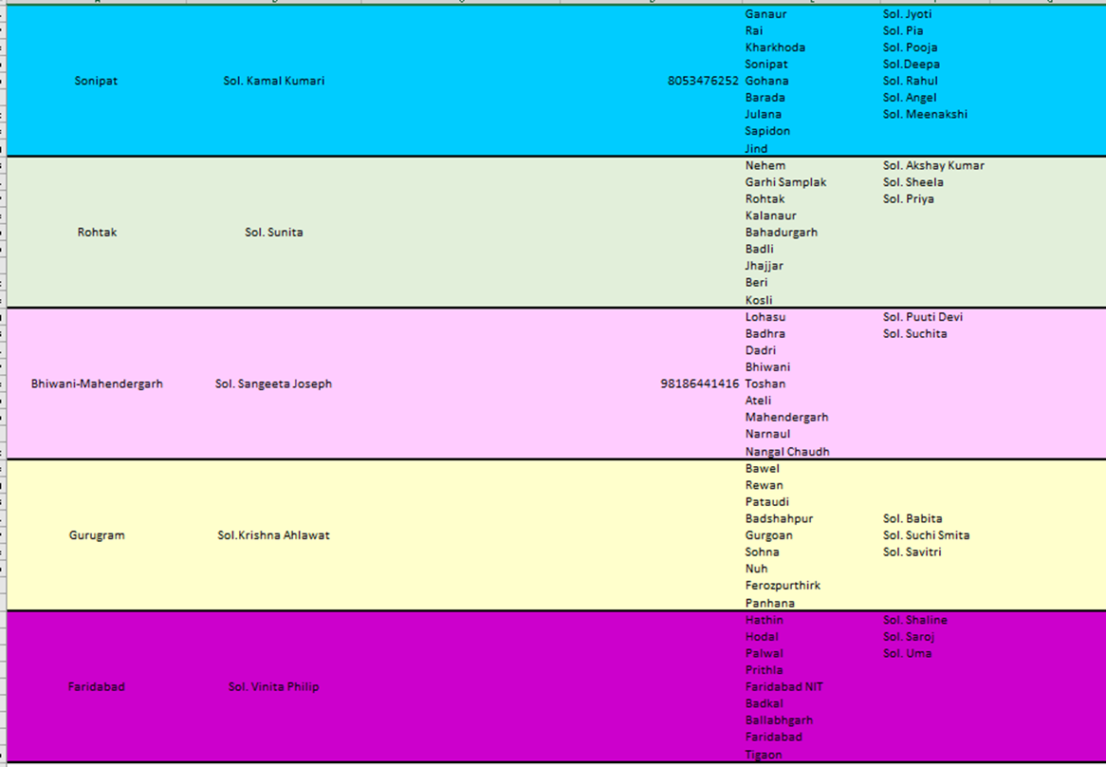

Slide 10

Haryana Troop Church Report
OCTOBER 2024

Slide 11

TROOP CHURCH

Slide 12
LEADER : SOL.USHA SHARMA
DATE: 01/10/24 TO 09/10/24
TIME : 12:00 TO 1:30 PM
MEMBERS : 06-08
ESTHER TROOP CHURCH

Slide 13
YUSUF TROOP CHURCH
Leader- Sol. SUNITA CALESTIO
Date : 20/10/2024 to 28 /10 /2024
Time : 12 :00 to 1:30 PM
MEMBERS : 05 - 08

Slide 14
testimony
Sol. Richa’s son was having some issues in his eyes . God healed his eyes completely . Sister gives all glory to God.
Sol. Pramila’s daughter-in-law was expecting . She delivered a baby boy after the prayers were done for her in the troop church. She is grateful to God.
Sol. Usha ‘s son was extremely sick . God healed him after the prayers were done for him in the troop church. She is grateful to God.
Sol. Lata has severe arthritis in her legs. She wanted to go for BFF but was helpless to go there . God opened a door for her and Sol.Laxmi along with her helped her and took her for BFF classes to Greater Noida . We give all glory to Christ.
Sol. Premika wanted to earn for her family as she is a widow . She had asked for prayers in the Troop Church . God helped her and she could open her small grossary shop for her livelihood. We give all glory to God.

Slide 15

ARMY OF JESUS OPERATIONS

Slide 16
Gift Schools

Slide 17

NEHEMIAH SCHOOL OF ADMINISTRATION
DATE : 14 /10/2024TO 23/10/2024
TIME : 12:00 TO 1:30 PM
MEMBERS: 07-13

Slide 18
TESTIMONIES
All the soldiers liked the classes.
Soldiers found the classes to be very informative.
They learnt that they have been given authority as administrators by God .
Soldiers also learnt about the qualities of a good administrator .
Soldiers learnt about how God favours administrators.

Slide 19
MORNING WORSHIP - 05:30 am to 07:00 am

Slide 20
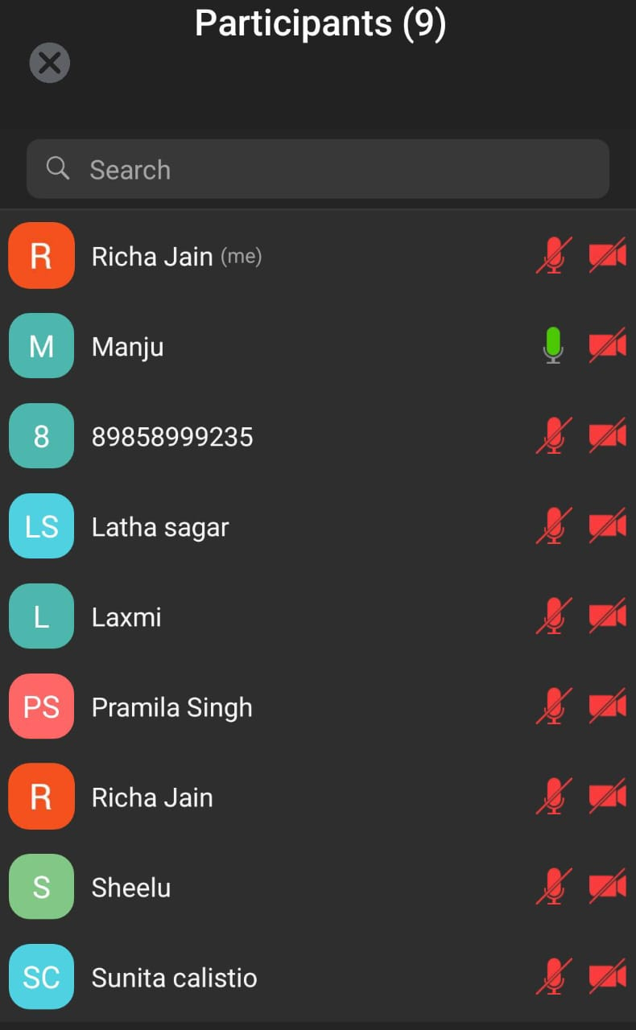
ZONAL MEETING
DATE : 25/10/24
TIME : 12:00 TO 1:30 PM

Slide 21
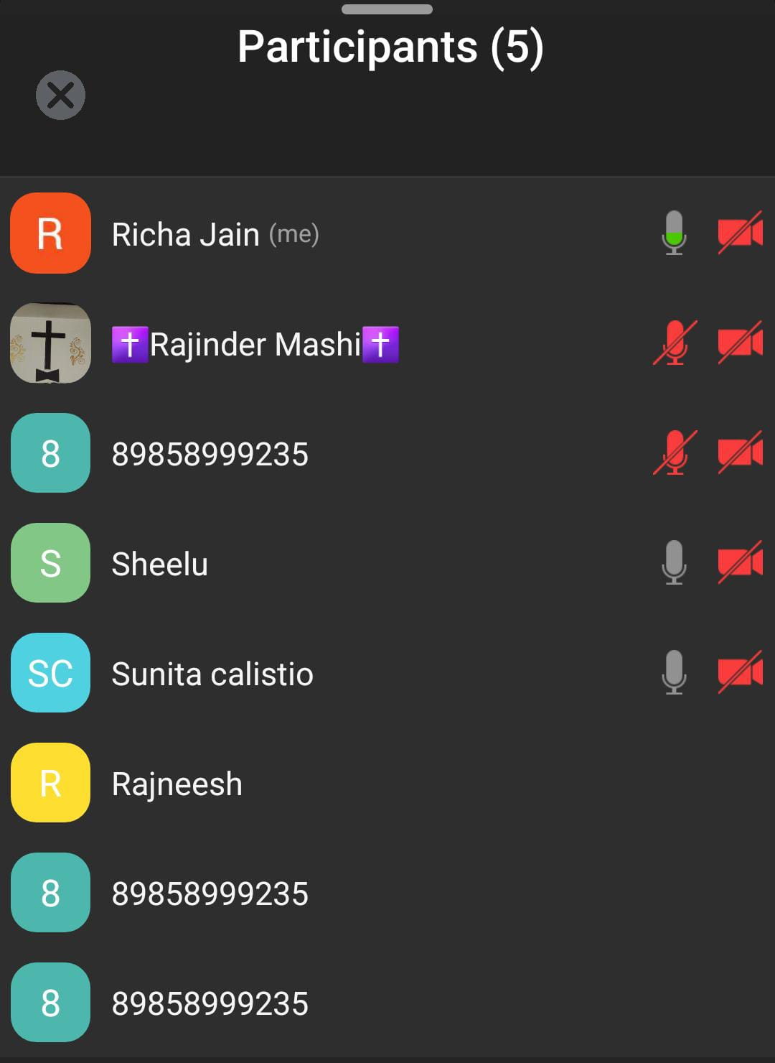
NIGHT PRAYER
DATE : 25/10/24
TIME : 10:00 TO 12:00 AM

Slide 22
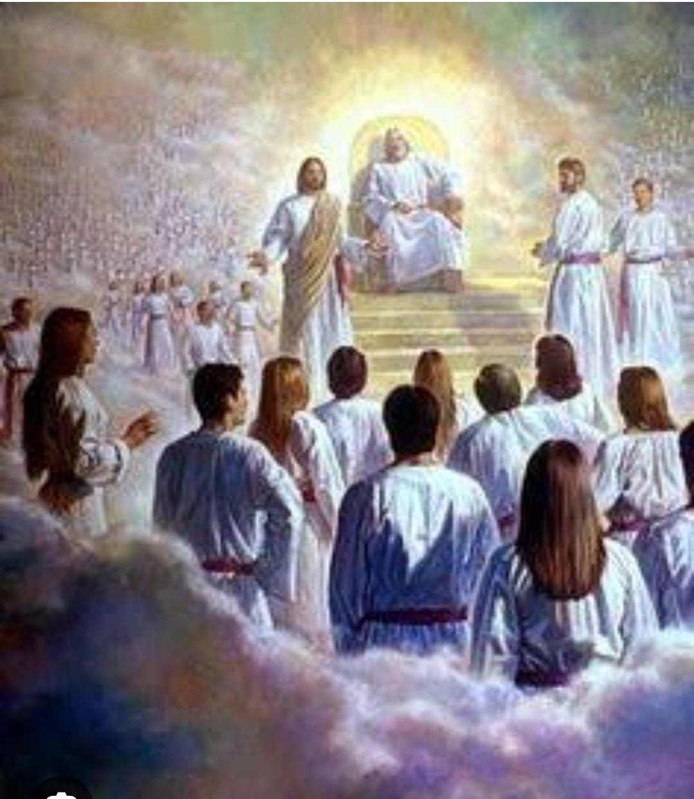
SHADOW PARLI
29/10/24
12:00-1:30pm

Slide 23


COUNTRY ADOPTED BY HARYANA
In the Enlarge my border meeting (EMB) held in Chennai in the month of November, 2021, as part of God’s plan, every State adopted one or more countries to preach the unadulterated word through Troop Churches, Morning Worship and Gift Schools. Accordingly the State of Haryana has adopted CYPRUS country .
We are praying to God to open the doors to fulfill this vision.

Slide 24



