Slide 1

HARYANA
Praise Report
APRIL - SEPTEMBER 2024

Slide 2
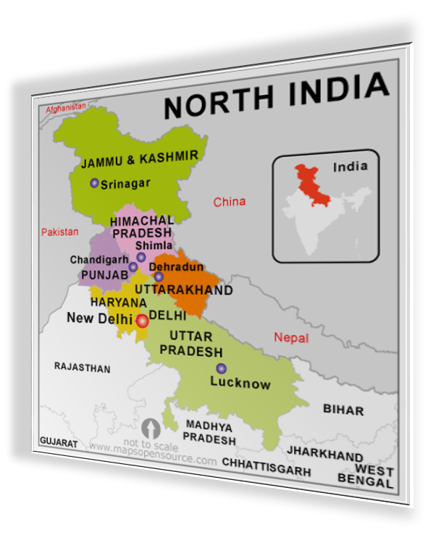
Be fruitful, multiply and fill the Earth
Genesis 1:28

Slide 3
States & Union Territories
DELHI
HARYANA
PUNJAB
CHANDIGARH
JAMMU & KASHMIR
LADAKH
HIMACHAL PRADESH
UTTAR PRADESH (W)
UTTARAKHAND

Slide 4


Slide 5


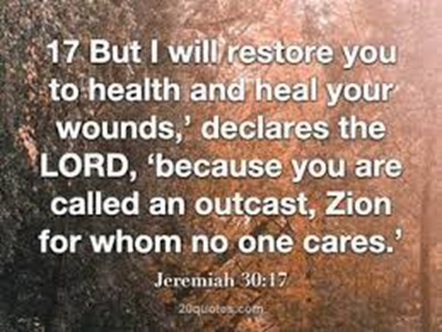

Slide 6
CORE TEAM
OF NORTH REGION
Speaker – Sol. Richa
Deputy Speaker – Sol. Rohit
Coordinator – Sol. Amrita
Secretary – Sol. Amarjeet

Slide 7

SMLA CONSTITUENCIES AND INCUMBENTS

Slide 8

PRAISE GOD FOR HIS MIGHTY DEEDS IN THE CAPITAL OF INDIA !!!
OUR PRAYERS ARE CONTINUALLY BEING ANSWERED IN JESUS MIGHTY NAME.
AMEN !!!

Slide 9
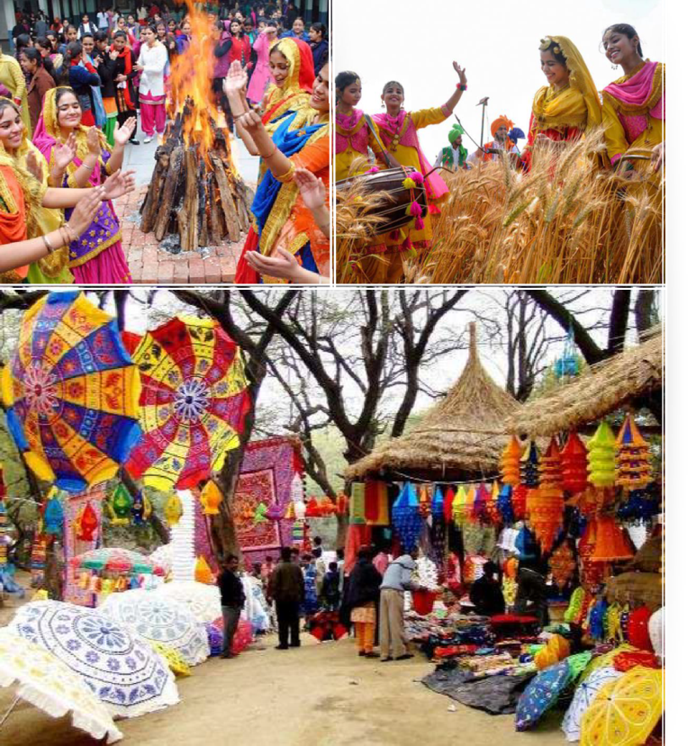

Haryana

Slide 10
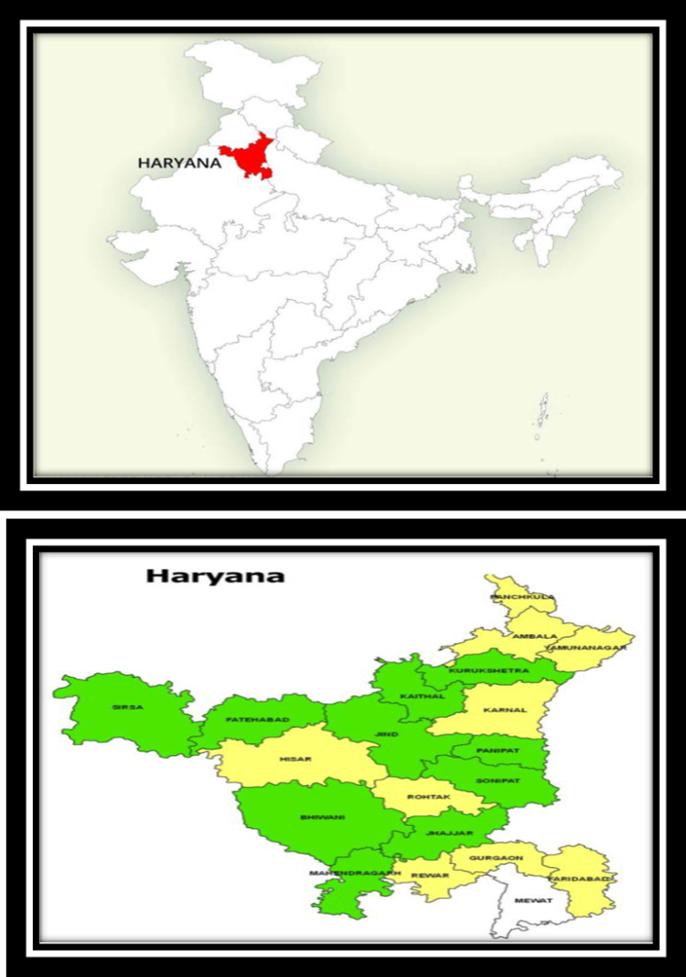
CARVED OUT OF THE FORMER STATE OF EAST PUNJAB ON 1 NOVEMBER 1966 ON A LINGUISTIC BASIS CAPITAL & MOST POPULOUS CITY IS FARIDABAD. FINANCIAL AND TECHNOLOGY HUBS. AND PART OF NCR. ALSO CONSIDERED ONE OF THE MAJOR INFORMATION TECHNOLOGY AND AUTOMOBILE HUBS OF INDIA.
RICH IN HISTORY, MONUMENTS, HERITAGE, FLORA AND FAUNA AND TOURISM, WITH A WELL DEVELOPED ECONOMY, NATIONAL HIGHWAYS AND STATE ROADS, IT IS BORDERED BY HIMACHAL PRADESH TO THE NORTH-EAST, BY RIVER YAMUNA ALONG ITS EASTERN BORDER WITH UTTAR PRADESH, BY RAJASTHAN TO THE WEST AND SOUTH, AND GHAGGAR-HAKRA RIVER FLOWS ALONG ITS NORTHERN BORDER WITH PUNJAB.

Slide 11


COUNTRY ADOPTED BY HARYANA
In the Enlarge my border meeting (EMB) held in Chennai in the month of November, 2021, as part of God’s plan, every State adopted one or more countries to preach the unadulterated word through Troop Churches, Morning Worship and Gift Schools. Accordingly the State of Haryana has adopted CYPRUS country .
We are praying to God to open the doors to fulfill this vision.

Slide 12
Haryana Core Team
Speaker – Sol. RICHA
Deputy Speaker – Sol. USHA SHARMA
Co-ordinator – Sol. SUNITA
Secretary – Sol. SEEMA/GEETA

Slide 13

Constituencies of Haryana

Slide 14
SMPs | CONSTITUENCIES
AMBALA | SOL. KAMLA
AMBALA KURUKSHETRA | SOL.GITA SOL. RICHA
SIRSA | SOL. KAMLESH
KARNAL HISSAR | SOL.SHEELU SOL. RAJENDRA
KARNAL | SOL. USHA
SONIPAT ROHTAK | SOL. LATA RAJVEER
ROHTAK | SOL. KAJAL
BHIWANI-MAHENDARGARH SIRSA | SOL. SEEMA SOL. MAMTA
GURGAON | SOL. NEELAM SHARMA
FARIDABAD GURUGRAM | SOL. USHA SHARMA SOL. SUNITA CALESTIO

Slide 15


SMLAs Constituencies and Incumbents

Slide 16
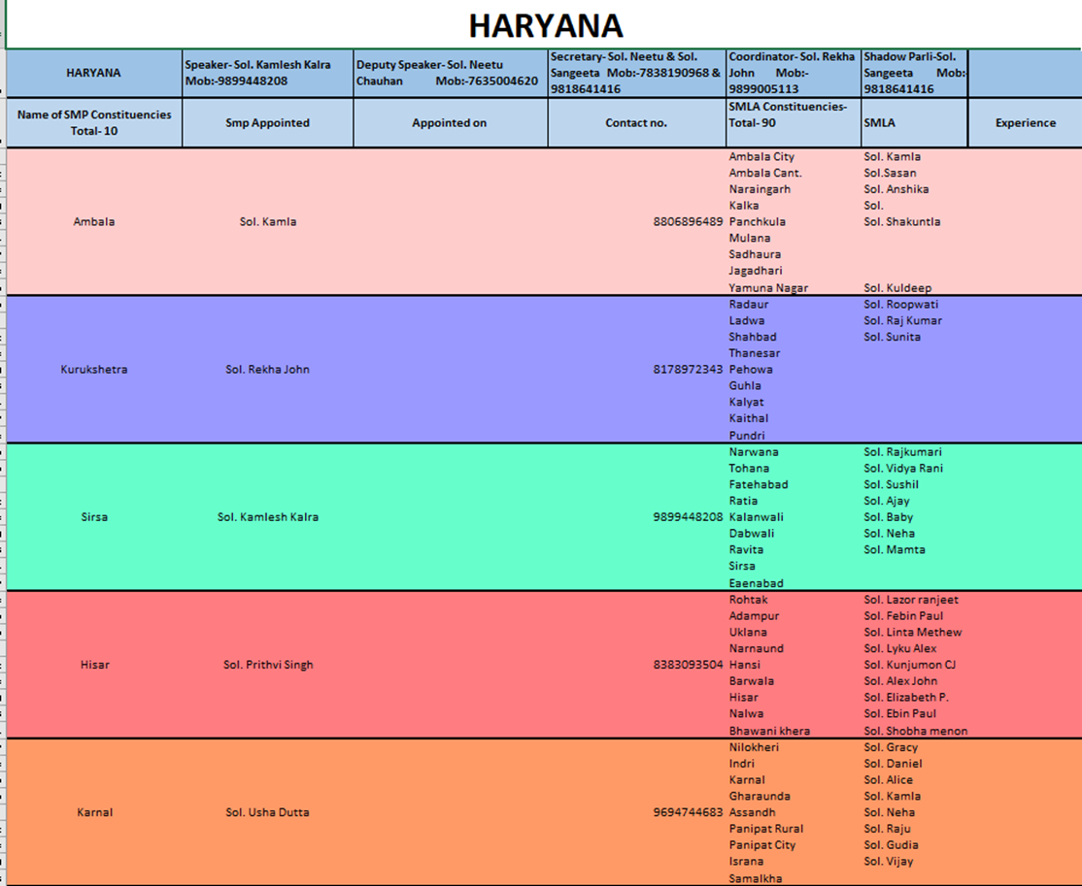

Slide 17
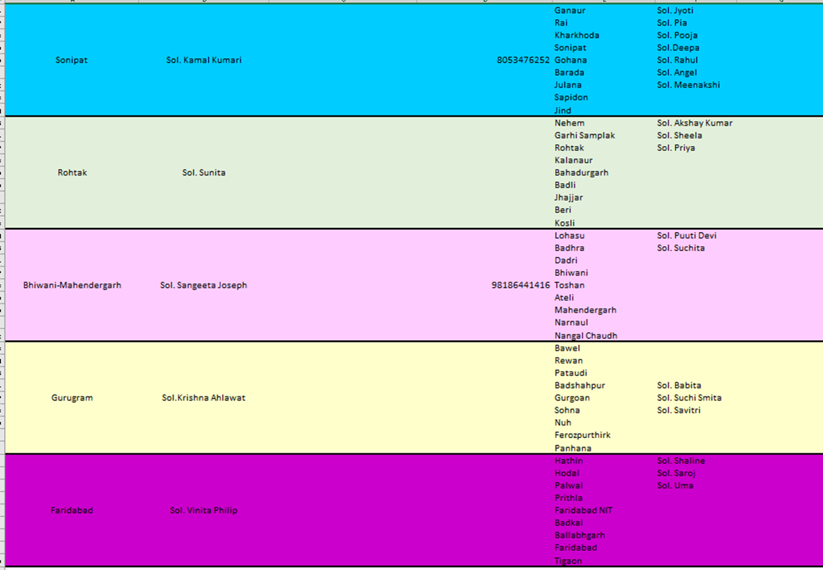

Slide 18

Haryana Troop Church Report
APRIL 2024

Slide 19

TROOP CHURCH

Slide 20
LEADER : SOL.SWEETY
DATE: 01/04/24 TO 08/04/24
TIME : 12:00 TO 1:30 PM
MEMBERS : 10- 11
PETER TROOP CHURCH

Slide 21
ESTHER TROOP CHURCH
Leader- Sol. MAMTA
Date : 18/04/2024 to 26 /04 /2024
Time : 12 :00 to 1:30 PM
MEMBERS : 11

Slide 22
testimony
Sol. Mamta’s sister-in-law was sick. Sol. Mamta prayed for her ,she became alright . God healed her. . Sister gives all glory to God.
Sol. Sushila has testified that after joining AOJ she feels happy and there is peace in her heart . She was very disheartened as there are many issues in her family but she is very hopeful now. She gives all glory to Christ.
Sol. Premika wanted to purchase bible but she could not. Our Lord miraculously sent a bible to her through someone.She is grateful to God.
Sol. Premika has testified that whenever she prays for anything ,God hears her. She is grateful to God.
Sol. Mamta shared the gospel with one person and he accepted the Lord . All glory to God.

Slide 23

ARMY OF JESUS OPERATIONS

Slide 24
Gift Schools

Slide 25

JOSEPH SCHOOL OF FINANCIAL DISCIPLINE
DATE : 01 /04/2024TO 08/04/2024
TIME : 12:00 TO 2:00 PM
MEMBERS: 12

Slide 26
. Soldiers have claimed that they CAME TO KNOW HOW TO discipline themselves financially .
SOLDIERS came to know why love for money is the root cause of all evil.
. Soldiers have come to know about wealth and riches in bible.
.
TESTIMONIES

Slide 27

MARTHA school of HOSPITALITY
DATE : 19 /04/2024 TO 25/04/24
TIME : 12:00 TO 2:00 PM
MEMBERS: 11-14

Slide 28
TESTIMONIES
All the soldiers liked the classes.
Soldiers found the classes to be very informative.
They learnt about hospitality.
Soldiers learnt how to deal with difficult people
Soldiers learnt the importance of working in a team.

Slide 29
MORNING WORSHIP - 05:30 to 07:00 am

Slide 30
Zonal Meeting
On 29.04.2024
Time: 12:00 pm to 01:30 pm
Members: 12

Slide 31
NIGHT PRAYER
DATE : 12th APRIL
TIME : 10:00 TO 12:00 PM
MEMBERS : 11

Slide 32
Haryana Troop Church Report
MAY 2024

Slide 33
TROOP CHURCH

Slide 34
LEADER : SOL.MAMTA
DATE: 01/05/24 TO 08/05/24
TIME : 12:00 TO 1:30 PM
MEMBERS : 09- 10
YAHOVA NISSI TROOP CHURCH

Slide 35
DANIEL TROOP CHURCH
Leader- Sol. SUNITA
Date : 20/05/2024 to 27 /05 /2024
Time : 12 :00 to 1:30 PM
MEMBERS : 06-07

Slide 36
testimony
Sol. Mamta’s sister-in-law was sick. Sol. Mamta prayed for her ,she became alright . God healed her. . Sister gives all glory to God.
Sol. Sushila has testified that after joining AOJ she feels happy and there is peace in her heart . She was very disheartened as there are many issues in her family but she is very hopeful now. She gives all glory to Christ.
Sol. Premika wanted to purchase bible but she could not. Our Lord miraculously sent a bible to her through someone . She is grateful to God.
Sol. Premika has testified that whenever she prays for anything ,God hears her. She is grateful to God.
Sol. Mamta shared the gospel with one person and he accepted the Lord . All glory to God.

Slide 37
ARMY OF JESUS OPERATIONS

Slide 38
Gift Schools

Slide 39

FRP -1
DATE : 07 /05/2024TO 12/05/2024
TIME : 12:00 TO 1:30 PM
MEMBERS: 14-15

Slide 40
TESTIMONIES
All the soldiers liked the classes.
Soldiers found the classes to be very informative.
They learnt why it is important to forgive others .
Soldiers also learnt about various demon doors .
Soldiers learnt how the curses start operating in ones family or life.

Slide 41
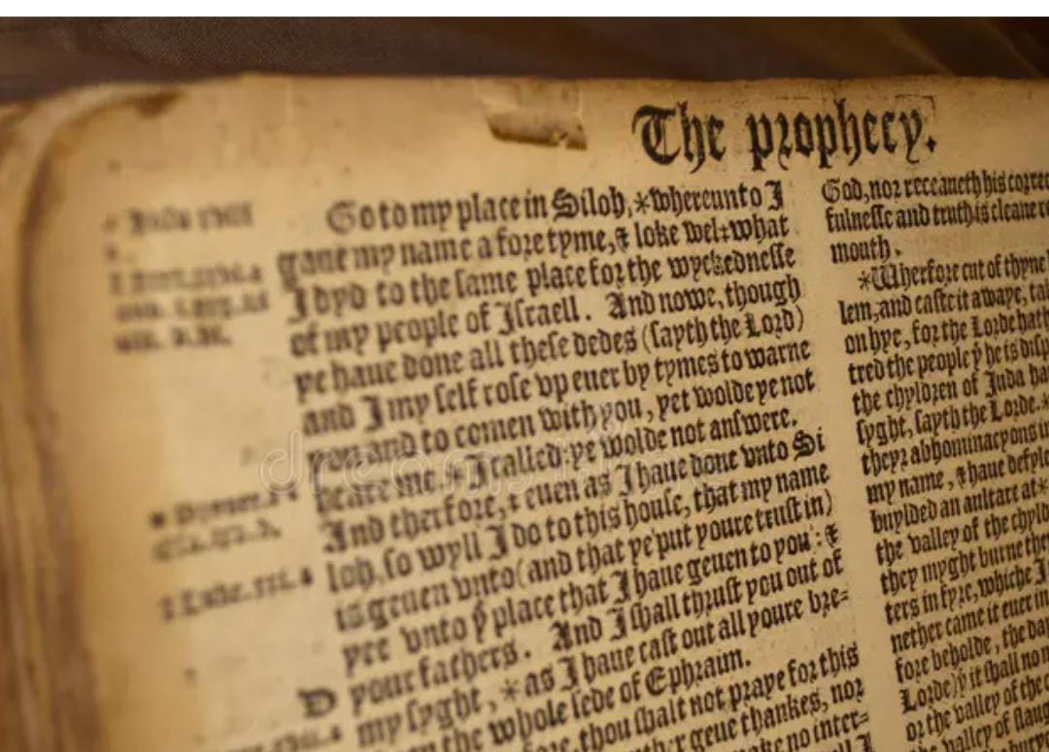
JEREMIAH school of PROPHECY-1
DATE : 13 /05/2024 TO 17/05/24
TIME : 12:00 TO 1:30 PM
MEMBERS: 09-10

Slide 42
. Soldiers have learnt how to have intimacy with god. .
SOLDIERS came to know HOW TO handle revelations.
. Soldiers have come to know about various principles of hearing from god.
.
TESTIMONIES

Slide 43
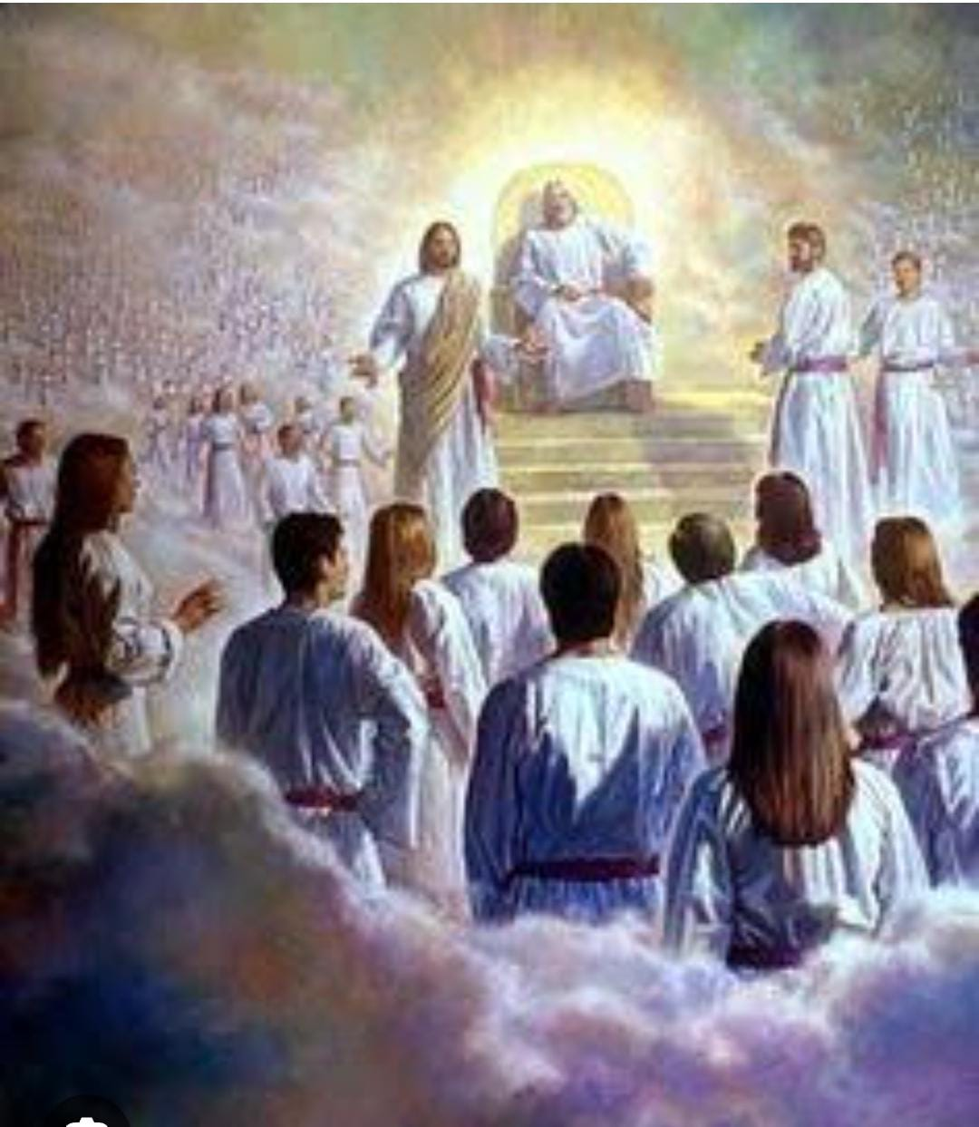
SHADOW PARLI
22/05/24
12:00-1:30pm

Slide 44
MORNING WORSHIP - 05:30 am to 07:00 am

Slide 45
Zonal Meeting
On 28.05.2024
Time: 12:00 pm to 01:30 pm
Members: 11

Slide 46
NIGHT PRAYER
DATE : 12th MAY
TIME : 9:00 TO 11:00 PM
MEMBERS : 11

Slide 47
Haryana Troop Church Report
JUNE 2024

Slide 48
LEADER : SOL.SWEETIE
DATE: 10/06/24 TO 14/06/24
TIME : 12:00 TO 1:30 PM
MEMBERS : 09- 10
YAHOVA NISSI TROOP CHURCH

Slide 49
TROOP CHURCH

Slide 50
LEADER : SOL.SWEETIE
DATE: 10/06/24 TO 14/06/24
TIME : 12:00 TO 1:30 PM
MEMBERS : 09- 10
YAHOVA NISSI TROOP CHURCH

Slide 51
DANIEL TROOP CHURCH
Leader- Sol. SUNITA
Date : 26/06/2024 to 01 /07 /2024
Time : 12 :00 to 1:30 PM
MEMBERS : 06-07

Slide 52
testimony
Sol. Mamta’s sister-in-law was sick. Sol. Mamta prayed for her ,she became alright . God healed her. . Sister gives all glory to God.
Sol. Lata has testified that after joining AOJ she feels happy and there is peace in her heart . She was very disheartened as there are many issues in her family but she is very hopeful now. She gives all glory to Christ.
Sol. Pramila has testified that God is helping her in many difficult situations . She is grateful to God.
Sol. Premika has testified that whenever she prays for anything ,God hears her. She is grateful to God.
Sol. Sheelu has also testified that after joining AOJ she is feeling blessed . She is very happy with the spiritual food that she is getting in AOJ.

Slide 53
ARMY OF JESUS OPERATIONS

Slide 54
Gift Schools

Slide 55
BETHESDA SCHOOL OF HEALING -1
DATE : 17 /06/2024TO 24/06/2024
TIME : 12:00 TO 1:30 PM
MEMBERS: 10-12

Slide 56
TESTIMONIES
All the soldiers liked the classes.
Soldiers found the classes to be very informative.
They learnt about three types of sickness .
Soldiers also learnt how to destroy the strongholds .
Soldiers learnt how the curses start operating in ones family or life.

Slide 57

NEHEMIAH SCHOOL OF ADMINISTRATION
DATE : 04 /06/2024 TO 07/06/24
TIME : 12:00 TO 1:30 PM
MEMBERS: 09-10

Slide 58
. Soldiers have learnt how to be a good administrator .
SOLDIERS came to know HOW TO bring the kingdom of god by using the authority given by god as an administrator .
. Soldiers learnt about various successful administrators of the bible.
.
TESTIMONIES

Slide 59
SHADOW PARLI
15/06/24
12:00-1:30pm

Slide 60
MORNING WORSHIP - 05:30 am to 07:00 am

Slide 61
Zonal Meeting
On 18.06.2024
Time: 12:00 pm to 01:30 pm
Members: 09

Slide 62
Haryana Troop Church Report
JULY 2024

Slide 63
Haryana Core Team
Speaker – Sol. RICHA
Deputy Speaker – Sol. SUNITA CALESTIO
Co-ordinator – Sol. USHA SHARMA
Secretary – Sol. MAMTA/SEEMA

Slide 64
Constituencies of Haryana

Slide 65
SMPs | CONSTITUENCIES
AMBALA | SOL. KAMLA
KURUKSHETRA | SOL. GRACY
SIRSA | SOL. KAMLESH
HISSAR | SOL. MANU
KARNAL | SOL. USHA
SONIPAT | SOL. KAMAL KUMARI
ROHTAK | SOL. KAJAL
BHIWANI-MAHENDARGARH | SOL. SANGEETA
GURGAON | SOL. NEELAM SHARMA
FARIDABAD | SOL. VANITHA

Slide 66
TROOP CHURCH

Slide 67
LEADER : SOL.USHA
DATE: 01/07/24 TO 07/07/24
TIME : 12:00 TO 1:30 PM
MEMBERS : 09- 10
ABRAHAM TROOP CHURCH

Slide 68
PETER TROOP CHURCH
Leader- Sol. RICHA JAIN
Date : 15/07/2024 to 24 /07 /2024
Time : 12 :00 to 1:30 PM
MEMBERS : 06-07

Slide 69
testimony
Sol. Mamta met with an accident. God saved her as she received only bruises in some areas of her body. she is better now . God has healed her. . Sister gives all glory to God.
Sol. Pramila was not feeling well . She became little better after the prayers were done for her in the troop church. She is grateful to God.
Sol. Sheelu had asked for prayers . All the soldiers prayed for her in the troop church after which she felt little relieved.

Slide 70
ARMY OF JESUS OPERATIONS

Slide 71
Gift Schools

Slide 72

NAZARETH SCHOOL OF FAMILY BUILDING
DATE : 08 /07/2024TO 14/07/2024
TIME : 12:00 TO 1:30 PM
MEMBERS: 10-12

Slide 73
TESTIMONIES
All the soldiers liked the classes.
Soldiers found the classes to be very informative.
They learnt about godly order in a christian family .
Soldiers also learnt how to destroy the strongholds .
Soldiers learnt about the correct ways of upbringing their children.

Slide 74

MARTHA SCHOOL OF HOSPITALITY
DATE : 25 /07/2024 TO 31/07/24
TIME : 12:00 TO 1:30 PM
MEMBERS: 09-10

Slide 75
. Soldiers have learnt how to show hospitality to others .
SOLDIERS came to know HOW TO deal with difficult people .
. Soldiers learnt about building up godly and good moral character.
.
TESTIMONIES

Slide 76
SHADOW PARLI
20/07/24
12:00-1:30pm

Slide 77
MORNING WORSHIP - 05:30 am to 07:00 am

Slide 78
Haryana Troop Church Report
August 2024

Slide 79
TROOP CHURCH

Slide 80
Leader : Sol. Richa
Date: 01/08/24 To 09/08/24
Time : 12:00 To 1:30 Pm
Members : 09- 10
YAHOVA TROOP CHURCH

Slide 81
ESTHER TROOP CHURCH
Leader- Sol. Usha
Date : 20/08/2024 To 28 /08 /2024
Time :12 :00 To 1:30 PM
Members :10 - 13

Slide 82
testimony
Sol. Mamta met with an accident. God saved her as she received only bruises in some areas of her body. she is better now . God has healed her. . Sister gives all glory to God.
Sol. Pramila was not feeling well . She became little better after the prayers were done for her in the troop church. She is grateful to God.
Sol. Sheelu had asked for prayers . All the soldiers prayed for her in the troop church after which she felt little relieved.

Slide 83
ARMY OF JESUS OPERATIONS

Slide 84
Gift Schools

Slide 85

JOSEPH SCHOOL OF FINANCIAL DISCIPLINE
DATE : 12 /08/2024TO 19/08/2024
TIME : 12:00 TO 1:30 PM
MEMBERS: 10-13

Slide 86
TESTIMONIES
All the soldiers liked the classes.
Soldiers found the classes to be very informative.
They learnt why love for money is not good .
Soldiers also learnt how to be faithful in little .
Soldiers learnt about the details of what all comes in stealing.

Slide 87
MORNING WORSHIP
05:30 am to 07:00 am
Monday- Friday

Slide 88
SHADOW PARLI
30/08/24
12:00-1:30pm

Slide 89

24 hrs WORSHIP (only sundays)
ALL NORTH REGION STATES

Slide 90
ZONAL MEETING
DATE : 19 /08/2024
TIME : 12:00 pm TO 01:30 pm
MEMBERS: 09

Slide 91
Haryana Troop Church Report
SEPTEMBER 2024

Slide 92
TROOP CHURCH

Slide 93
LEADER : SOL.HARDEVI
DATE: 02/09/24 TO 08/09/24
TIME : 12:00 TO 1:30 PM
MEMBERS : 09- 13
AYUB TROOP CHURCH

Slide 94
DANIEL TROOP CHURCH
Leader- Sol. MAMTA
Date : 20/09/2024 to 28 /09 /2024
Time : 12 :00 to 1:30 PM
MEMBERS : 08 - 10

Slide 95
testimony
Sol. Richa fell sick. God healed her completely . Sister gives all glory to God.
Sol. Pramila was not feeling well . She is now much better after the prayers were done for her in the troop church. She is grateful to God.
Sol. Usha Sharma developed high sugar level. She recovered within few days and her sugar level became normal . She is grateful to God.
Sol. Lata had viral infection . She was taken to hospital by her daughter who was not on talking terms with her .After much care she has completely recovered and mother – daughter have reconciled with each other. We give all glory to Christ.
Sol. Sheelu had asked for prayers . All the soldiers prayed for her in the troop church after which she felt little peace in her heart.

Slide 96
ARMY OF JESUS OPERATIONS

Slide 97
Gift Schools

Slide 98
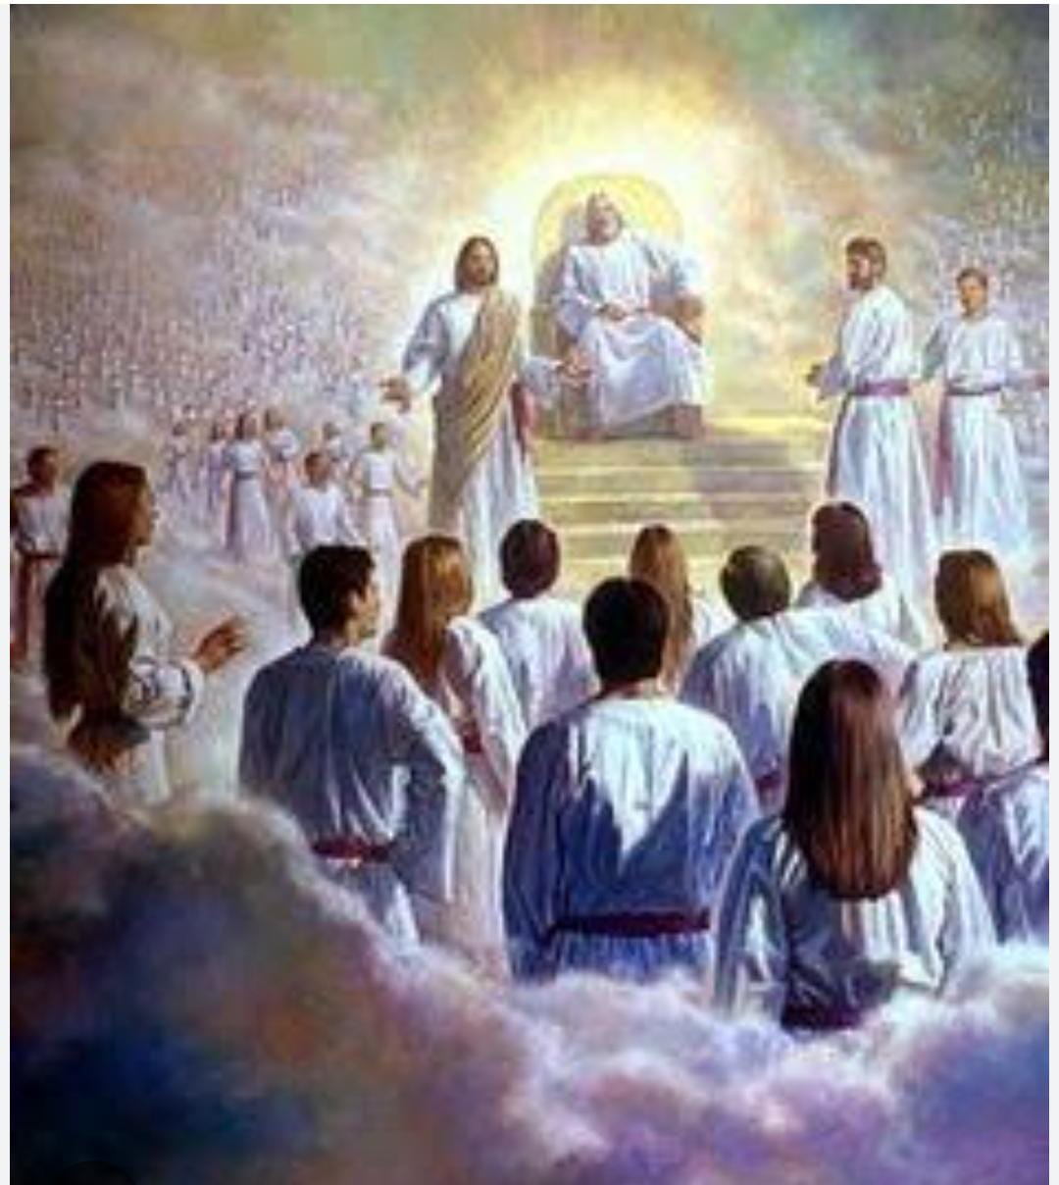
frp - 2
DATE : 09 /09/2024TO 17/09/2024
TIME : 12:00 TO 1:30 PM
MEMBERS: 10-13

Slide 99
TESTIMONIES
All the soldiers liked the classes.
Soldiers found the classes to be very informative.
They learnt about the heavenly court .
Soldiers also learnt about the heavenly books .
Soldiers learnt about the types of voices heard in heaven.

Slide 100
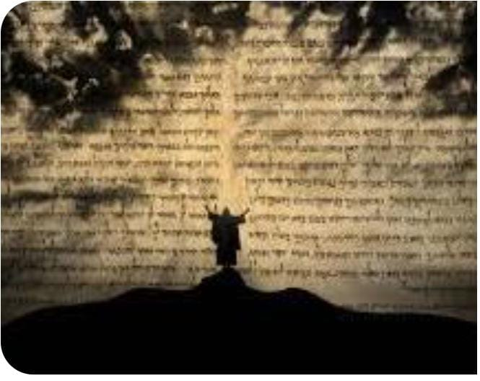
jeremiah school of prophecy-1
DATE : 18 /09/2024TO 24/09/2024
TIME : 12:00 TO 1:30 PM
MEMBERS: 10-13

Slide 101
TESTIMONIES
All the soldiers liked the classes.
Soldiers found the classes to be very informative.
They learnt how to go to prophecy over their circumstances .
Soldiers also learnt how to hear from God .
Soldiers learnt how to write prophetic decree .

Slide 102
MORNING WORSHIP - 05:30 am to 07:00 am

Slide 103
ZONAL MEETING
DATE : 28/09/24
TIME : 12:00 TO 1:30 PM

Slide 104
SHADOW PARLI
30/09/24
12:00-1:30pm

Slide 105


ARMY OF JESUS OPERATIONS

Slide 106



